Slide 1
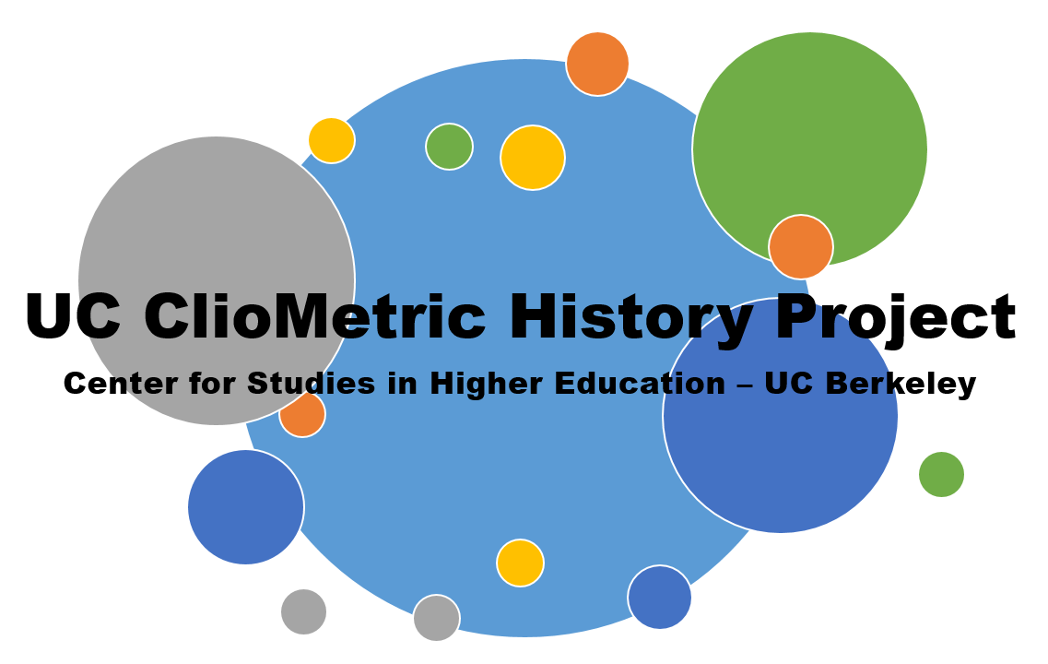
Digitization Methodology and Formatted Optical Character Recognition (fOCR)
February 16, 2018
Zach Bleemer
Department of Economics
UC Berkeley

Slide 2
Problem: Digital record only extends back to late 20th century
Massive administrative data availability has revolutionized applied microeconomics
e.g. Chetty et al (2017), Kirkeboen, Leuven, and Mogstad (2016), Arcidiacono, Aucejo, and Hotz (2016)
Economic historians constrained to the computer-readable, despite key advantages:
Fewer privacy and copyright restrictions
Longer available panel of outcomes
Digitization tools often arduous (or costly) and difficult to scale

Slide 3
Micro-Level Digitization
Unstructured records
Gentzkow (2016), Hoberg and Phillips (2016; forthcoming)
Large literature outside economics
Semi-structured records
Moser (2005), Brunet (2017)
Fully-structured records
Large federal surveys (Census, SCF, etc.), Goldin and Katz (2000), Feigenbaum (2015)

Slide 4
Idea: Scalable digitization
Need not include document scanning, which can be outsourced to libraries
HathiTrust Digital Library (Google partnership) holds 19 million volumes
(Near-)entire UC system scanned; organized by California Digital Library
Should solve two quality issues:
Algorithmically identify records’ structure and produce tabular output
Algorithmically correct typos arising from imperfect OCR

Slide 5
Why economists?
Commercial software inefficient for large-scale digitization
Higher benefit than other technical disciplines; lower cost than other social sciences
Similar to causal inference techniques
Resulting data amenable to standard econometric analysis

Slide 6
Outline
Formatted Optical Character Recognition (fOCR) Protocol
Vignette 1: Semi-Structured
Vignette 2: Fully Structured
Data Post-Processing

Slide 7
Formatted Optical Character Recognition (fOCR) Protocol
Part One

Slide 8
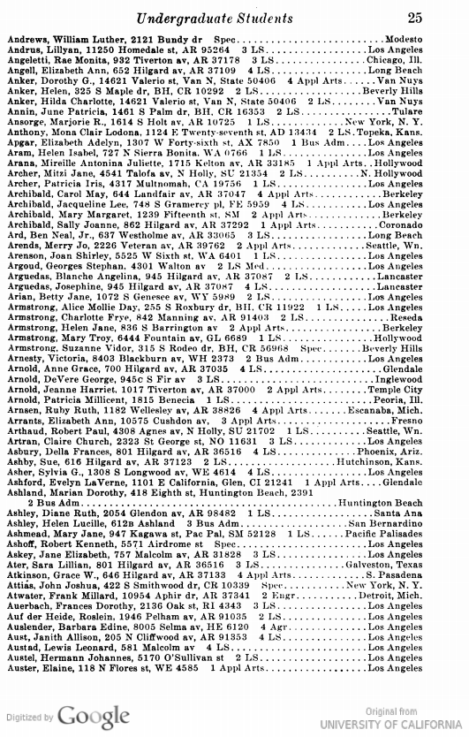
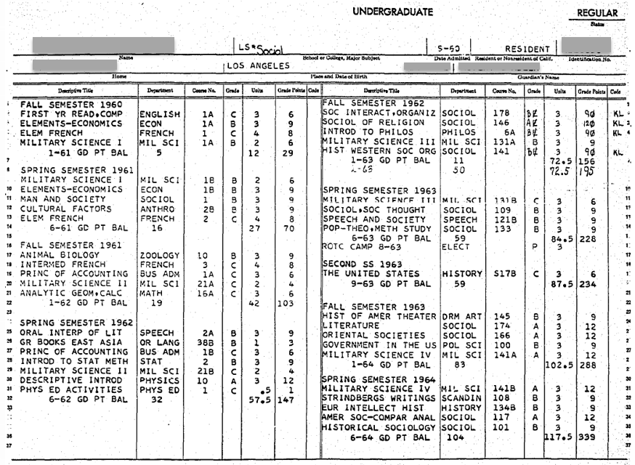

Slide 9

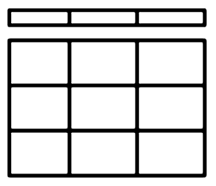


Formatted Optical Character Recognition (fOCR)
Stage Zero
Scan
Stage One OCR
Stage Two
Format
Stage Three
Collate

Slide 10
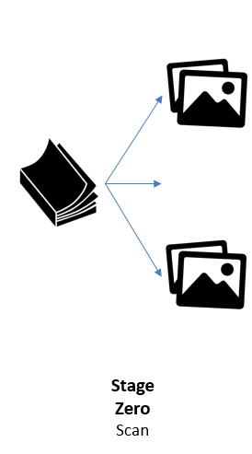
Stage 0: Record -> Images
More is better
Quality need not be uniformly high
Librarians or RAs

Slide 11
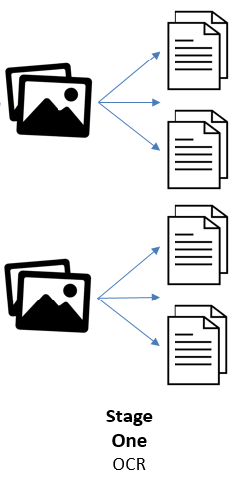
Stage 1: Images -> Transcriptions
More is better
Quality need not be uniformly high
At least four proprietary programs with batch processing

Slide 12
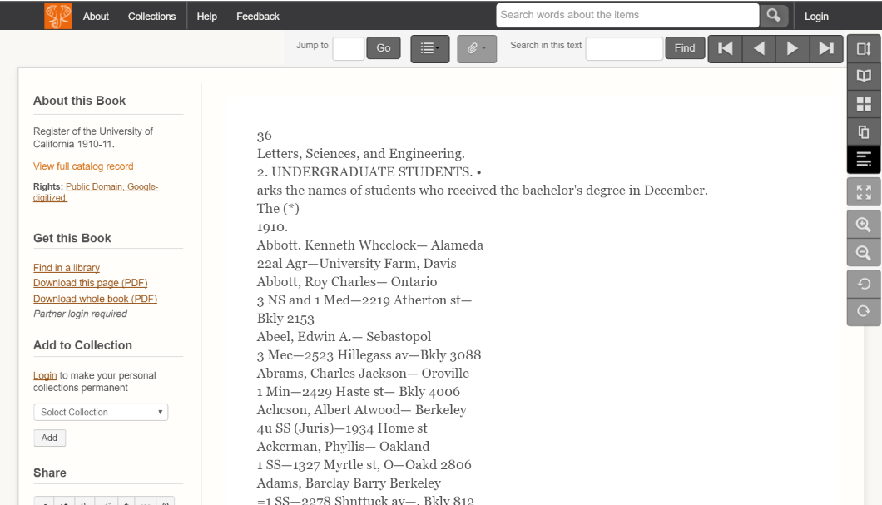
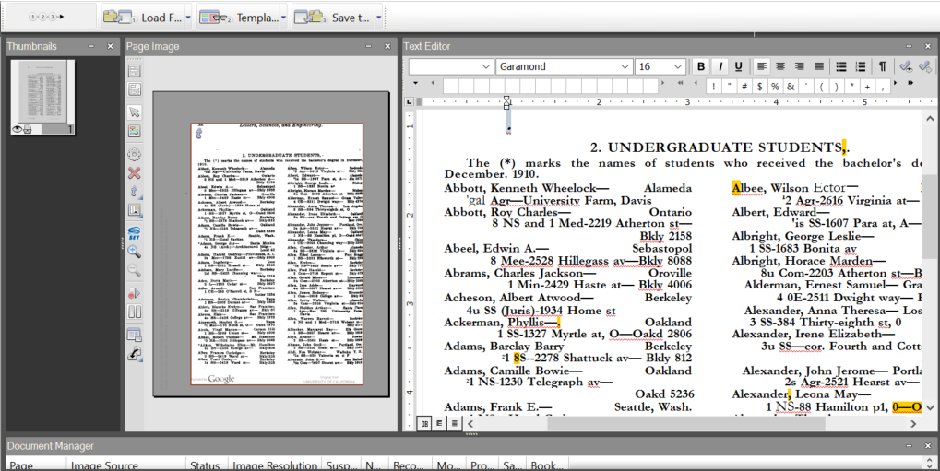
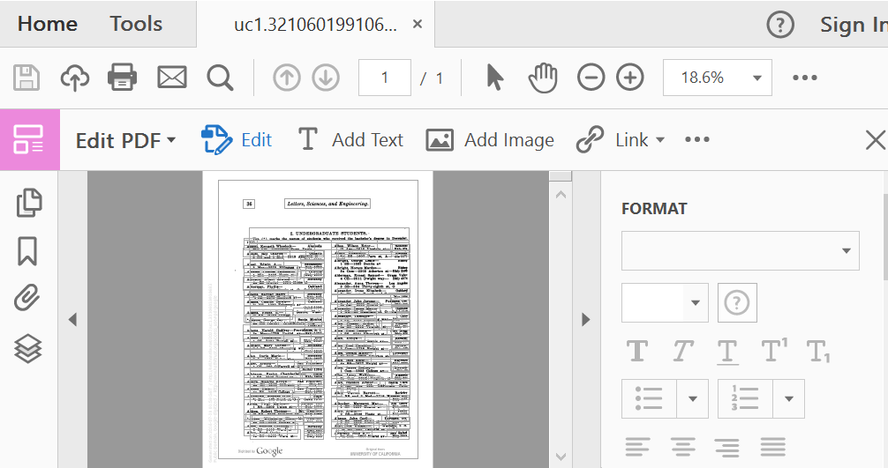
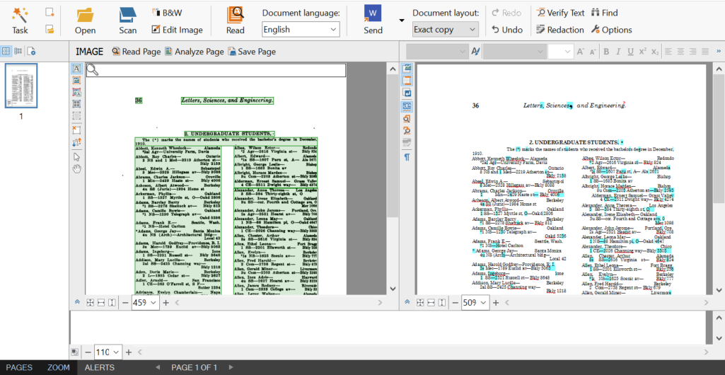
Stage 1: Images -> Transcriptions
Tesseract
OmniPage
Adobe
ABBYY

Slide 13
Stage 1: Images -> Transcriptions

Slide 14
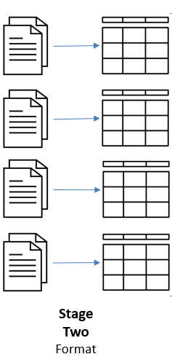
Stage 2: Transcriptions -> Tables
Uses patterns in transcriptions to organize data tabularly
Discards extraneous information
Retains ‘meta-data’

Slide 15
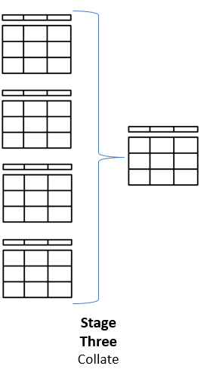
Stage 3: Tables -> Final Table
Algorithmically determines highest-quality information
Supervised (date format) or unsupervised (‘vote’, record count)
Remainder is discarded

Slide 16
Semi-Structured fOCR: 1927 UCLA Student Directory

Slide 17
Stage 0: Scan
Completed by HathiTrust, Google, and 3 university libraries
Five copies available

Slide 18
Stage 1: OCR
Armstrong, IIelen Jane, 836 S Barrington av 2 Appl Arts ………… Berkeley \n Armstrong, Mary Troy. 6444 Fountain av, GL 6689 1 LS ………… Hollywood \n Armstrong, Suzanne Vidor, 315 S Rodeo dr, BH, CR 56968 Spec ….... Beverly Hills
Armstrong, Helen Jane, 836 S Barrington av 2 AppI Arts ………… Berkeley \n Armstrong, Mary Troy, 6444 Fountain av, GL 6689 1 LS ………… Hollywood \n Armstrong, Suzanne Vidor, 315 S Rodeo dr, BH, CR 56968 Sqee ….... Beverlv Hills
OCR to produce flat text files
Useful to pre-process resulting text

Slide 19
Stage 2: Format
Armstrong, IIelen Jane, 836 S Barrington av 2 Appl Arts ………… Berkeley \n Armstrong, Mary Troy. 6444 Fountain av, GL 6689 1 LS ………… Hollywood \n Armstrong, Suzanne Vidor, 315 S Rodeo dr, BH, CR 56968 Spec ….... Beverly Hills
Armstrong, Helen Jane, 836 S Barrington av 2 AppI Arts ………… Berkeley \n Armstrong, Mary Troy, 6444 Fountain av, GL 6689 1 LS ………… Hollywood \n Armstrong, Suzanne Vidor, 315 S Rodeo dr, BH, CR 56968 Sqee ….... Beverlv Hills
Pattern:
LName, FName (MName)?, Address #? Major …… HomeTown \n

Slide 20
Stage 2: Format
{Armstrong#IIelen#Jane#2 Appl Arts#Berkeley}\nArmstrong, Mary Troy. 6444 Fountain av, GL 6689 1 LS ………… Hollywood \n{Armstrong#Suzanne#Vidor#Spec#Beverly Hills}
{Armstrong#Helen#Jane#2#AppIArts#Berkeley}\n{Armstrong#Mary#Troy#1#LS#Hollywood} \n{Armstrong#Suzanne#Vidor#Sqee#Beverlv Hills}
Pattern:
LName, FName (MName)?, Address #? Major …… HomeTown \n

Slide 21
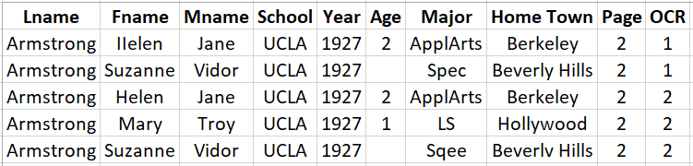
Stage 2: Format
Split text into bracketed segments, and segments into aligned columns

Slide 22
Stage 3: Collate
First: Choose page with more identified records
Second: Merge and improve information
Third: Discard Non-selected records

Slide 23
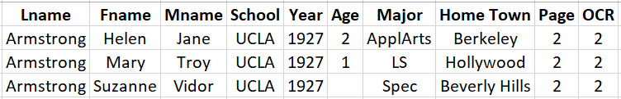
Result
Resulting data are structured, and higher-quality than any single transcription

Slide 24
UC Berkeley Student Statistics, 1908-1946

Slide 25
Fully Structured fOCR: 1950 Berkeley Transcript

Slide 26
Stage 0: Scan
Transferred to Microfiche in early 1990s; scanned to PDF in 2004
Two copies of every transcript

Slide 27
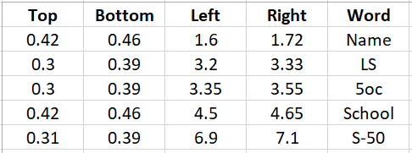
Stage 1: OCR
Key: OCR to produce XML file, which is easily converted to tabular form
As before, pre-process text for typos

Slide 28
Stage 2: Format
First identify template, using “fingerprint” words printed on record

Slide 29
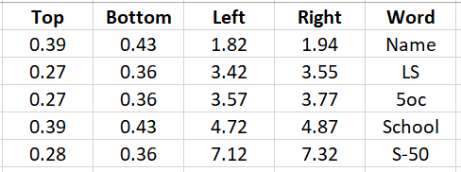
Stage 2: Format
Vertical: -0.03
Horizontal:
+0.22
Next, measure text offset compared to baseline (overall and by transcription)

Slide 30
Stage 2: Format
Now capture text in template-specific locations (using top-left coordinates)

Slide 31
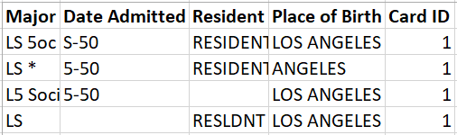
Stage 2: Format
Now capture text in template-specific locations (using top-left coordinates)

Slide 32
Stage 3: Collate
Collate field-by-field, choosing high-quality or most-appearing information

Slide 33

Stage 3: Collate
Collate field-by-field, choosing high-quality or most-appearing information

Slide 34
Structured Data Quality
Condition | Proportion 1970s Records | Proportion All Typewritten Records
Has Identifiable Field of Study | 97.1% | 91.9%
Has Identifiable Start Year | 95.9% | 92.6%
Has Identifiable Home Town | 95.0% | 85.9%
Same Name across Transcriptions | 91.8% | 84.6%
First Name Matches Gender Records* | 94.3% | 90.0%

Slide 35
Data Post-Processing
Part Two

Slide 36
What’s in a (Historical) Name
Gender
Match to SSA Records
Ethnicity
Machine-learn from Census
Class
Estimate from first name assignment

Slide 37
What’s in a (Historical) Name: Gender
Idea: Educated guess from first name
SSA records back to 1880: # children born in US by name and gender
Can assign gender when 10x more children born of one gender than other
~2.5 percent androgynous names (among college students)

Slide 38
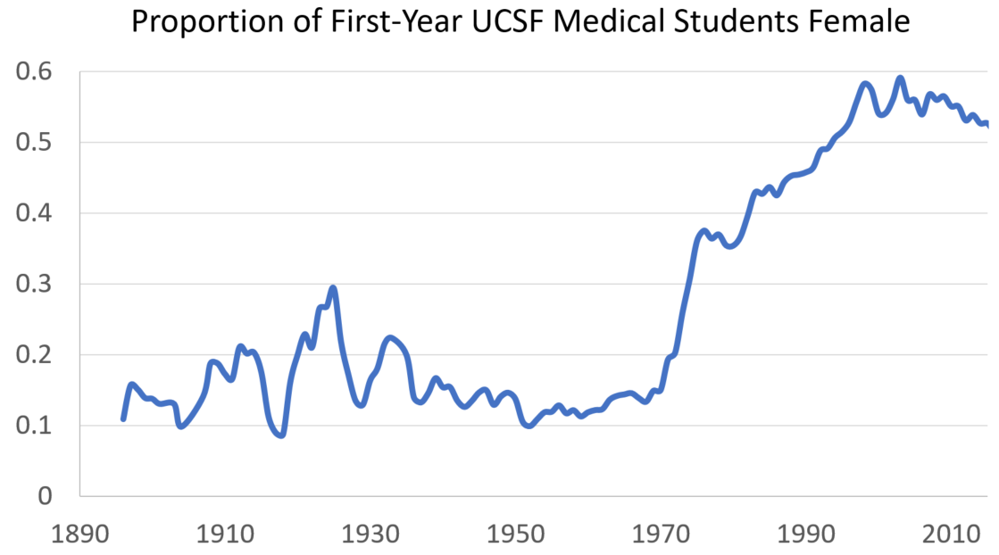
What’s in a (Historical) Name: Gender

Slide 39
What’s in a (Historical) Name: Ethnicity
Idea: Machine-learned estimate from three- and four-letter combinations in first and last names
Train on 10% oversampled 1910 Census
High-quality for some racial/ethnic groups
Japanese, Chinese, Eastern European, Italian, Hispanic
Lower-quality for earlier immigrants (German, Irish) and African-Americans

Slide 40
What’s in a (Historical) Name: Ethnicity

Slide 41
What’s in a (Historical) Name: Class
Idea: Estimate income from parents’ first name assignment
Regress parent occupation scores on first name indicators interacted with year and state of birth; assign coefficients to so-named individuals
Olivetti and Paserman (2015): Explains ~7% of variation in income
Think of this as an income stereotype measure

Slide 42
What’s in a (Historical) Name: Class

Slide 43
Other Text Extrapolations
Location
Generate complete city database (by state) from Wikipedia
Use for quality identification and to match to geographic coordinates
‘Within’ and ‘Across’ Linkages
Link by name, birth date, etc.
Jaro-Winkler [Feigenbaum (2017)] and other algorithms

Slide 44
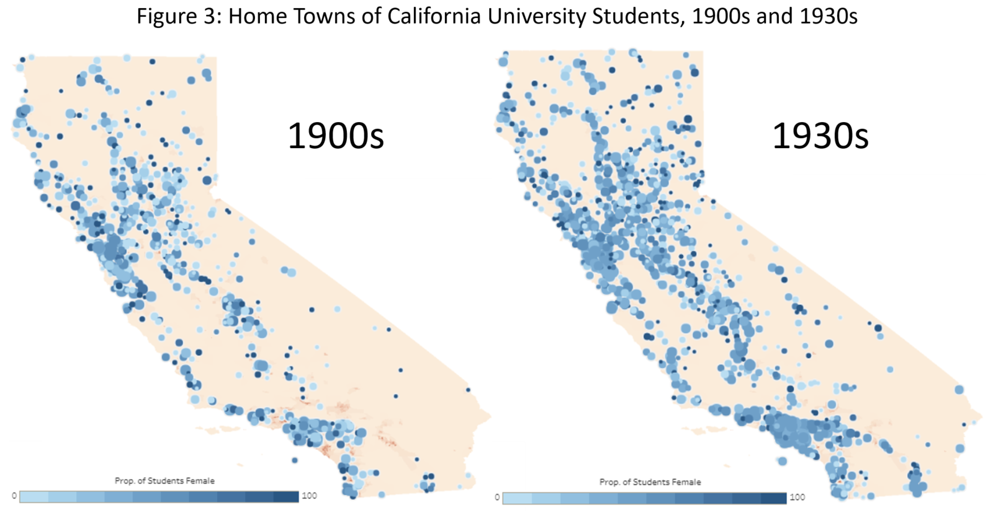
Other Text Extrapolations

Slide 45
Other Text Extrapolations
Figure 6: Distribution of Ladder-Rank Faculty, 1900 to the 21st Century
Professional
Professional
Humanities
Humanities
Social Sciences
Social Sciences
Natural Sciences
Natural Sciences
Engineering
Engineering

Slide 46
Conclusion
Algorithmic digitization is available to economic researchers
The combination of proprietary OCR software, regular expressions, and a bit of engineering yields high-quality data
Economists are well-situated to introduce innovations in producing data from semi- and fully-structured text records
These data are very valuable producing research in economic history, especially with regards to institutions (education, health, crime, etc.)
Massive individual-level data becomes more valuable as more is created

